Slide 1
2025 School of Columbianism
Grand Knight Training
Lonnie Treadaway
State Advocate
Mississippi Knights of Columbus
July, 2025

Slide 2
Grand Knight Training

Slide 3
1. Grand Knight Basic Training
Your Standing in the Order
Elected as Leader of the Council
Represent your Council
You must lead your Council
Accountability starts at the top
Supreme Council
State Council
District Deputy
Grand Knight
Council Officers
Council Directors

Slide 4
Your Duties
Lead by example
Work closely with your Priest
Be present
Always look for the opportunity to give another Catholic Man his “Why”
Drive activity

Slide 5
Responsibilities
Guide the overall growth and welfare of the council
Establish realistic goals for the council
Review progress toward attaining those goals and earning Star Council
Provide timely information on important dates and initiatives from the Supreme and State Councils

Slide 6
2. How to Succeed as a Grand Knight
Build Your Team
Form #185; Report of Officers Chosen for the Term
  Due by 6/30/2024

Slide 7
Build Your Team
Form #365; Service program Personnel Report
  Due by 6/30/2024

Slide 8
Lead by Being Present and Accessible
Attend meetings
Attend programs
Build relationships
Motivate members to become active
Conduct Ceremonials, Programs and Church Drives

Slide 9
Establish Goals
Every team needs an objective
Think beyond your council
Set goals for your parish and community
Short and long term goals

Slide 10
3. How to Manage Growth
Online Membership
Prospects can join in different ways (e-mail)
Can join the State Council (Online)
After exemplification, join the local council
Online membership is free
  Kofc.org/joinus
  Promo Code: BLESSEDMCGIVNEY

Slide 11
Membership Outreach
Flyers from Supreme/Insurance Agent
Online Membership Cards
Pulpit Speech
Pass out to men in the parish

Slide 12
Affiliate Membership
Some members become unresponsive over time
Councils can remove them from their rosters
Supreme engages them digitally
Find out if your councils have taken advantage of the program
  Saves the council money

Slide 13
4. Programs
Faith in Action
Faith: Grow in Faith
Family: Engage in the Family
Community: Serve the parish and community
Life: Defend the dignity of human life
Evangelize through action

Slide 14
Good Programs Equals Member Engagement
12-Month Program Plan
Good programs brings new member opportunities
Good programs impact potential new members and engage current members
Introduce new programs
Work with Churches and Pastors
Use the Fraternal Planner
Think outside the box

Slide 15
Eucharistic Processions
Contact your Pastor
Get involved
Be seen by parish
Wear your KC shirts and nametags

Slide 16
Cor – Evangelization and Formation for Men
Opportunity for Catholic Men to:
  Encounter Christ
  Strengthen their bonds of brotherhood
  Share their faith as Brothers
  Bring souls to Jesus Christ
Three Key Elements
  Prayer
  Formation
  Fraternity

Slide 17
5. Operations
We are reducing the workload
Combined Ceremonials
Streamlined meetings
Affiliate Member Initiative
Online Membership
Eliminating of Reports
New Membership Cards
More improvements on the way

Slide 18
Committees
Why Committees?
  Delegate and divide workload
  Involve men in leadership
  Helps meeting efficiency
Communicate report expectations
Encourage participation

Slide 19
Social and Fraternal Opportunities
Have a dinner before or after meeting
Organize family events
Organize social events
Get Pastor involved
Other Parish groups

Slide 20
Officers Online
Council dashboard with valuable tools
New Elects/Appointments receive access starting July 1
Invitation Code emailed after officer information is recorded on Forms 185/365

Slide 21
7. Communications
Communication Tips
Members have different communications preferences
  Text, email, bulletin, newsletter, phone
External communications are critical
  Parish, Community, Ministries, Other Councils
  Press Release

Slide 22
Fraternal Leader Advisory
Email from Supreme
Sent 1st and 3rd Thursdays of the month
Contains important announcements, news and best practices
Sent in English, French or Spanish
Sign-Up online

Slide 23
8. Meetings
Best Practices for Productive Meetings
Good meetings require preparation
Start and end on time
  No more than 1 hour
All reports should be 3 minutes or less
  Except for Chaplain and Grand Knight
Refer unexpected issues to committee meetings

Slide 24
Officer’s Planning Meeting Guidance
Ideally, not the same night as Council Meeting
Any council member may attend
Approve the agenda for the Council Meeting
Entertain new ideas, programs, and initiatives
Can be more relaxed, but make sure business gets done
Take care of details

Slide 25
Preparing for Council Meetings
Communicate your meeting to members in a timely manner
Include a fraternal/social element at each council meeting
Guests must be approved by the members
Distribute minutes electronically ahead of time
Use Robert’s Rules of Order
* Exceptions made for hybrid meetings

Slide 26
9. Training and Resources
Train Your Team
Use Fraternal Trainers
Attend Webinars
How-To Videos
www.kofc.org/training

Slide 27
Use the Supreme Website
www.kofc.org
Loads of information available

Slide 28
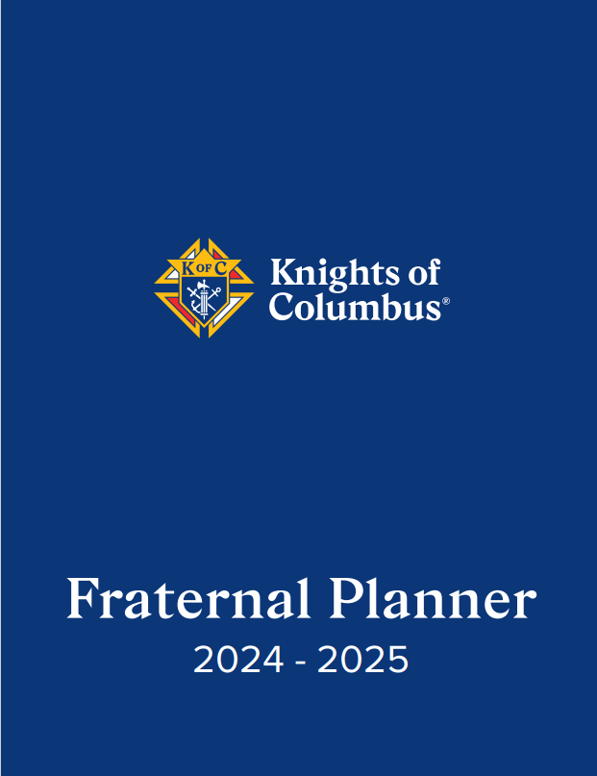
Use the Fraternal Planner
Best publication that Supreme puts out (My opinion)
Confirm events
Add state, parish, and community events to the calendar
Use the Council Activity Tracker at the bottom of each month

Slide 29
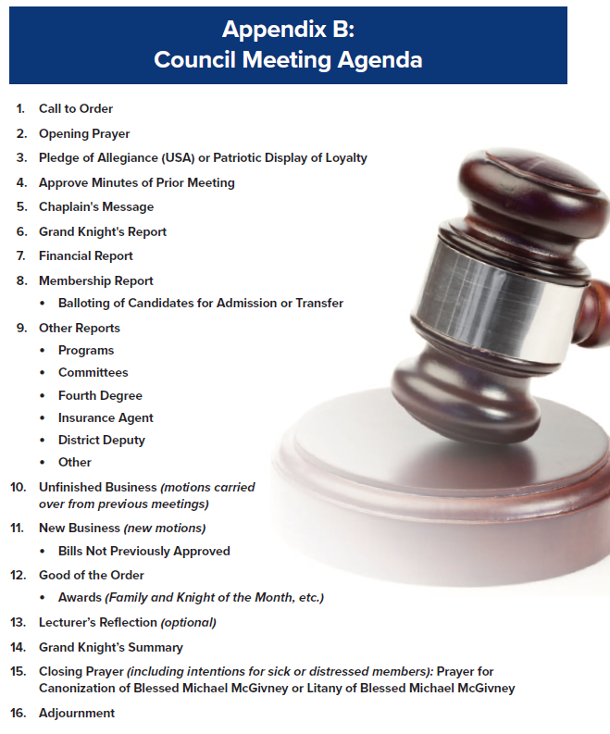
The Guidelines for Council Meetings
Council Meeting Agenda

Slide 30
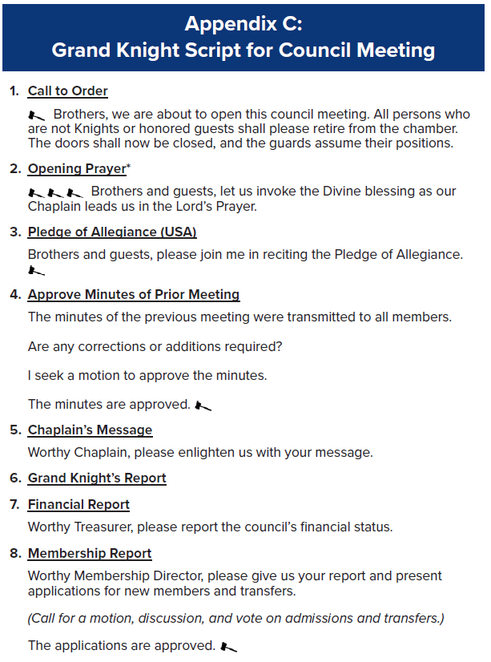
The Guidelines for Council Meetings
Grand Knight Script for Council Meeting

Slide 31
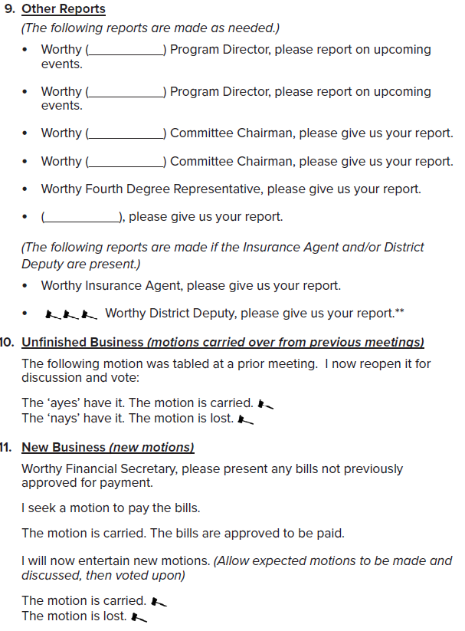
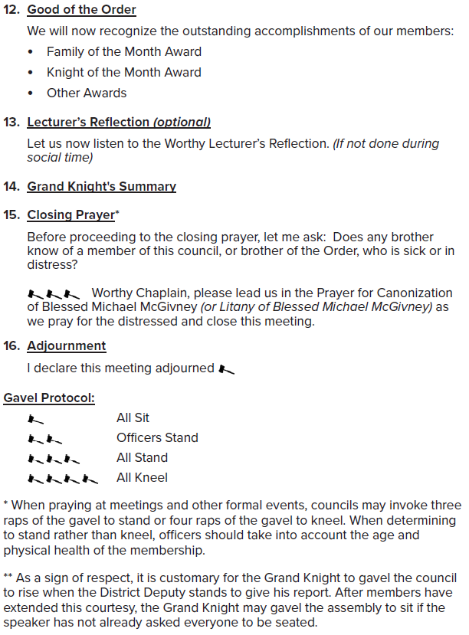

Slide 32
  Questions?
  Lonnie Treadaway
  State Advocate
  785 Church Road, W
  Southaven, MS 38671
  lonnie@flinn.com
  (901) 237-3167 (cell)

